Slide 1
Chapter 18 Recursion
Java How to Program, 11/e

Slide 2
Course Objectives
Understand and implement various data structures (List, Trees, etc.).
Utilize different sort and search algorithms.

Slide 3
Chapter Objectives
Describe the concept of recursion.
Explain recursive methods.
Determine the base case and the recursion step in a recursive algorithm.
Describe how recursive methods calls are handled by the system.
Describe the difference between recursion and iteration, and when to use each.
Describe what recursive backtracking is and why it’s an effective problem-solving technique.

Slide 4
18.1 Introduction
For some problems, it’s useful to have a method call itself.
Known as a recursive method.
Can call itself either directly or indirectly through another method.

Slide 5
18.2 Recursion Concepts
When a recursive method is called to solve a problem, it actually is capable of solving only the simplest case(s), or base case(s).
If the method is called with a base case, it returns a result.
If the method is called with a more complex problem, it divides the problem into two conceptual pieces
a piece that the method knows how to do and
a piece that it does not know how to do.
To make recursion feasible, the latter piece must resemble the original problem, but be a slightly simpler or smaller version of it.
Because this new problem resembles the original problem, the method calls a fresh copy of itself to work on the smaller problem
this is a recursive call
also called the recursion step

Slide 6
18.2 Recursion Concepts (Cont.)
The recursion step normally includes a return statement, because its result will be combined with the portion of the problem the method knew how to solve to form a result that will be passed back to the original caller.
The recursion step executes while the original method call is still active.
For recursion to eventually terminate, each time the method calls itself with a simpler version of the original problem, the sequence of smaller and smaller problems must converge on a base case.
When the method recognizes the base case, it returns a result to the previous copy of the method.
A sequence of returns ensues until the original method call returns the final result to the caller.

Slide 7
18.2 Recursion Concepts (Cont.)
A recursive method may call another method, which may in turn make a call back to the recursive method.
This is known as an indirect recursive call or indirect recursion.

Slide 8
18.3 Example Using Recursion: Factorials
Factorial of a positive integer n, written n! (pronounced “n factorial”), which is the product
n · (n – 1) · (n – 2) · … · 1
with 1! equal to 1 and 0! defined to be 1.
The factorial of integer number (where number ≥ 0) can be calculated iteratively (nonrecursively) using a for statement as follows:
factorial = 1;
for ( int counter = number; counter >= 1; counter-- ) factorial *= counter;
Recursive declaration of the factorial calculation for integers greater than 1 is arrived at by observing the following relationship:
n! = n · (n – 1)!
Figure 18.3 uses recursion to calculate and print the factorials of the integers from 0 through 21.

Slide 9
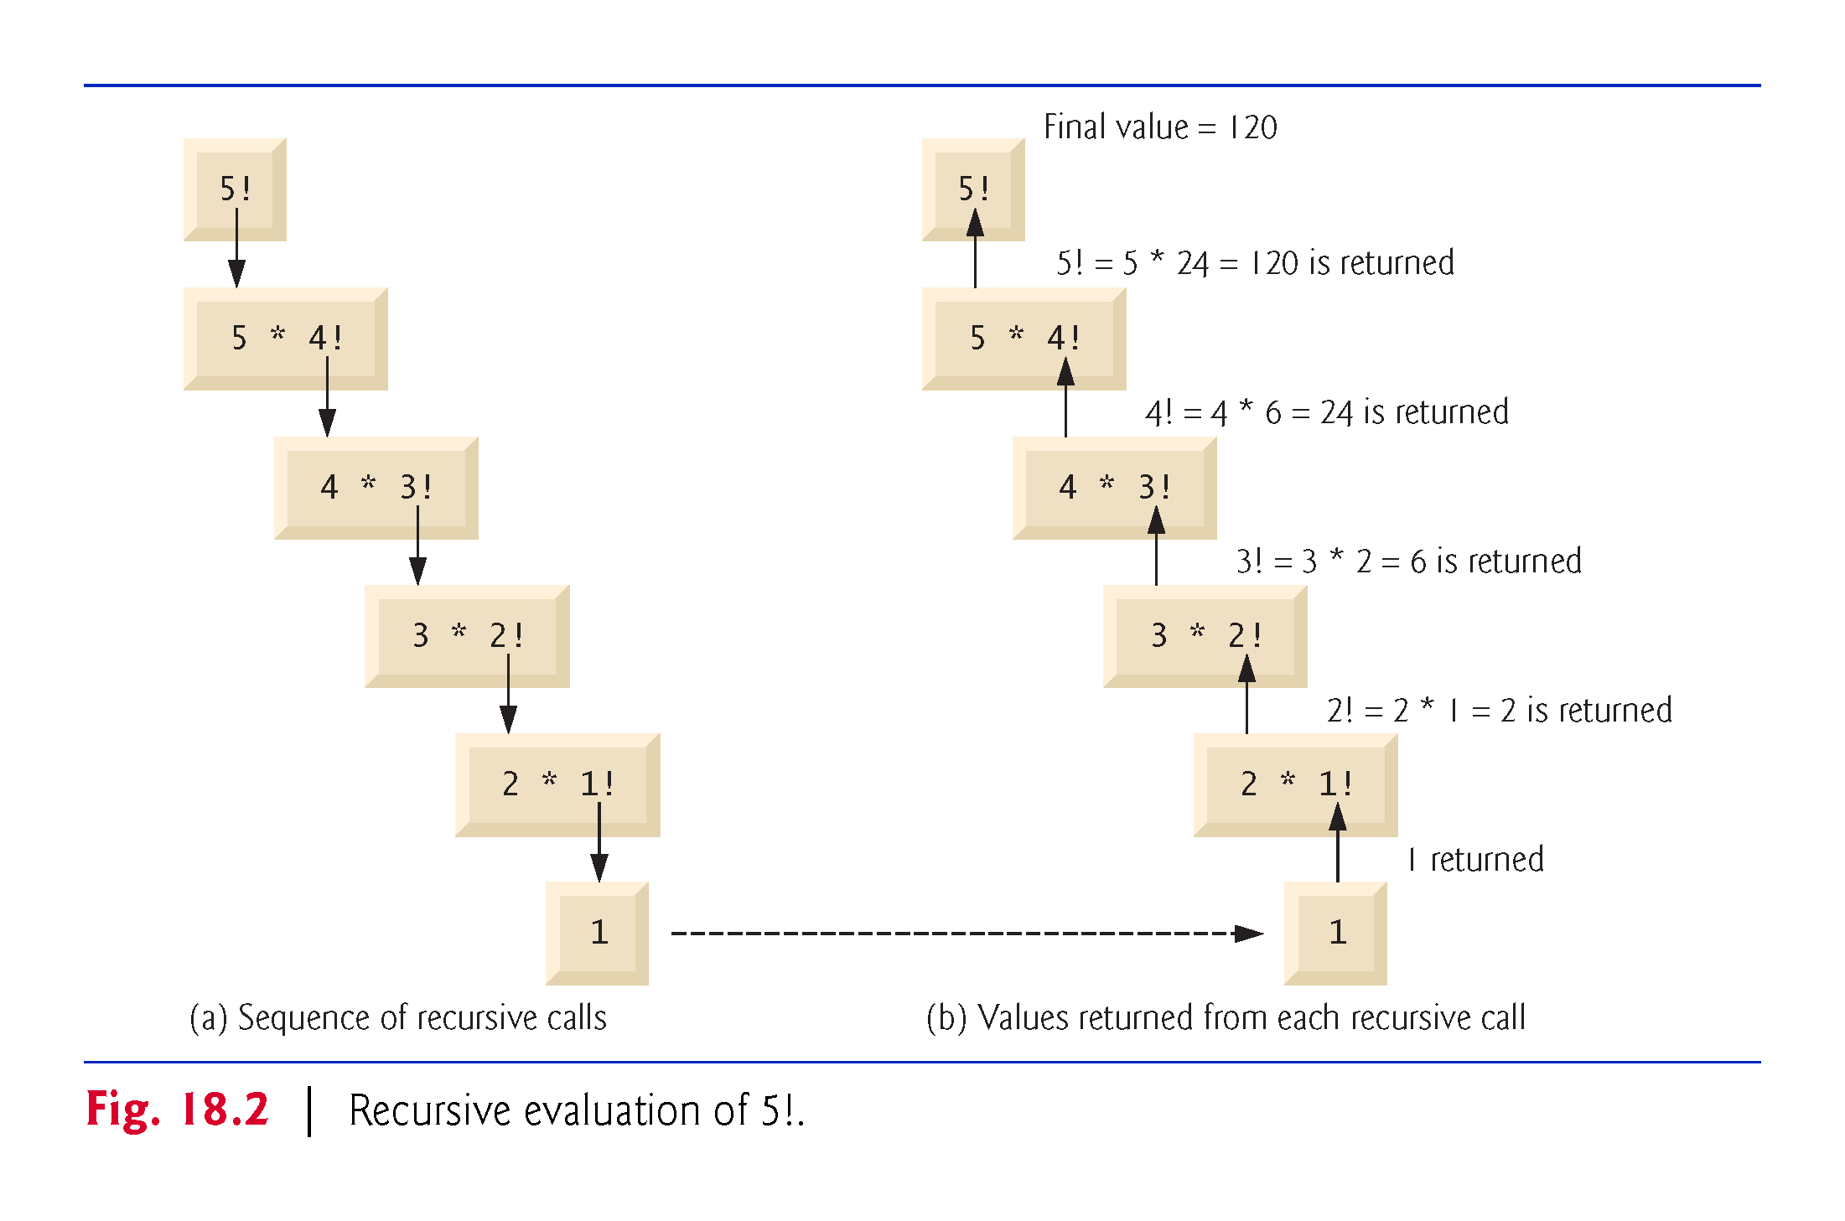

Slide 10
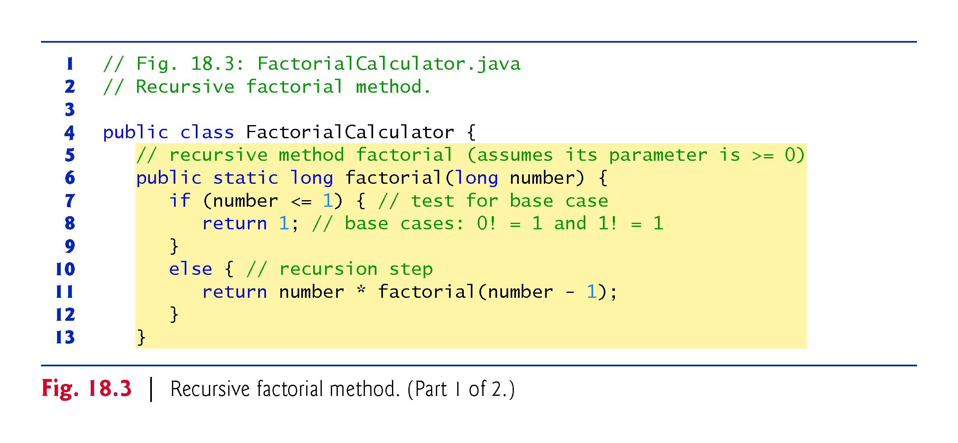

Slide 11
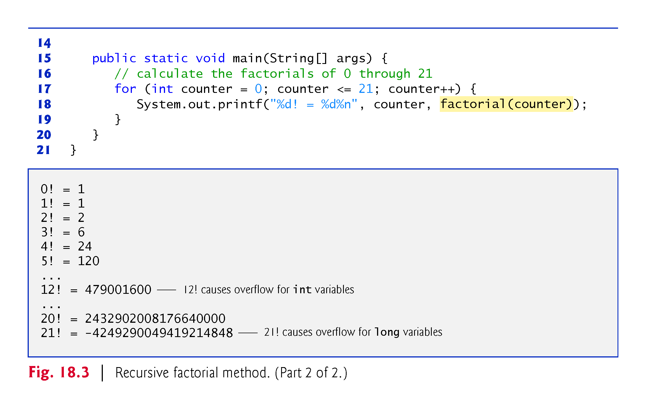

Slide 12
18.3 Example Using Recursion: Factorials (Cont.)
We use type long so the program can calculate factorials greater than 12!.
The factorial method produces large values so quickly that we exceed the largest long value when we attempt to calculate 21!.
Package java.math provides classes BigInteger and BigDecimal explicitly for arbitrary precision calculations that cannot be performed with primitive types.

Slide 13
18.4 Reimplementing Class FactorialCalculator Using BigInteger
Figure 18.4 reimplements class FactorialCalculator using BigInteger variables.
To demonstrate larger values than what long variables can store, we calculate the factorials of the numbers 0–50.

Slide 14
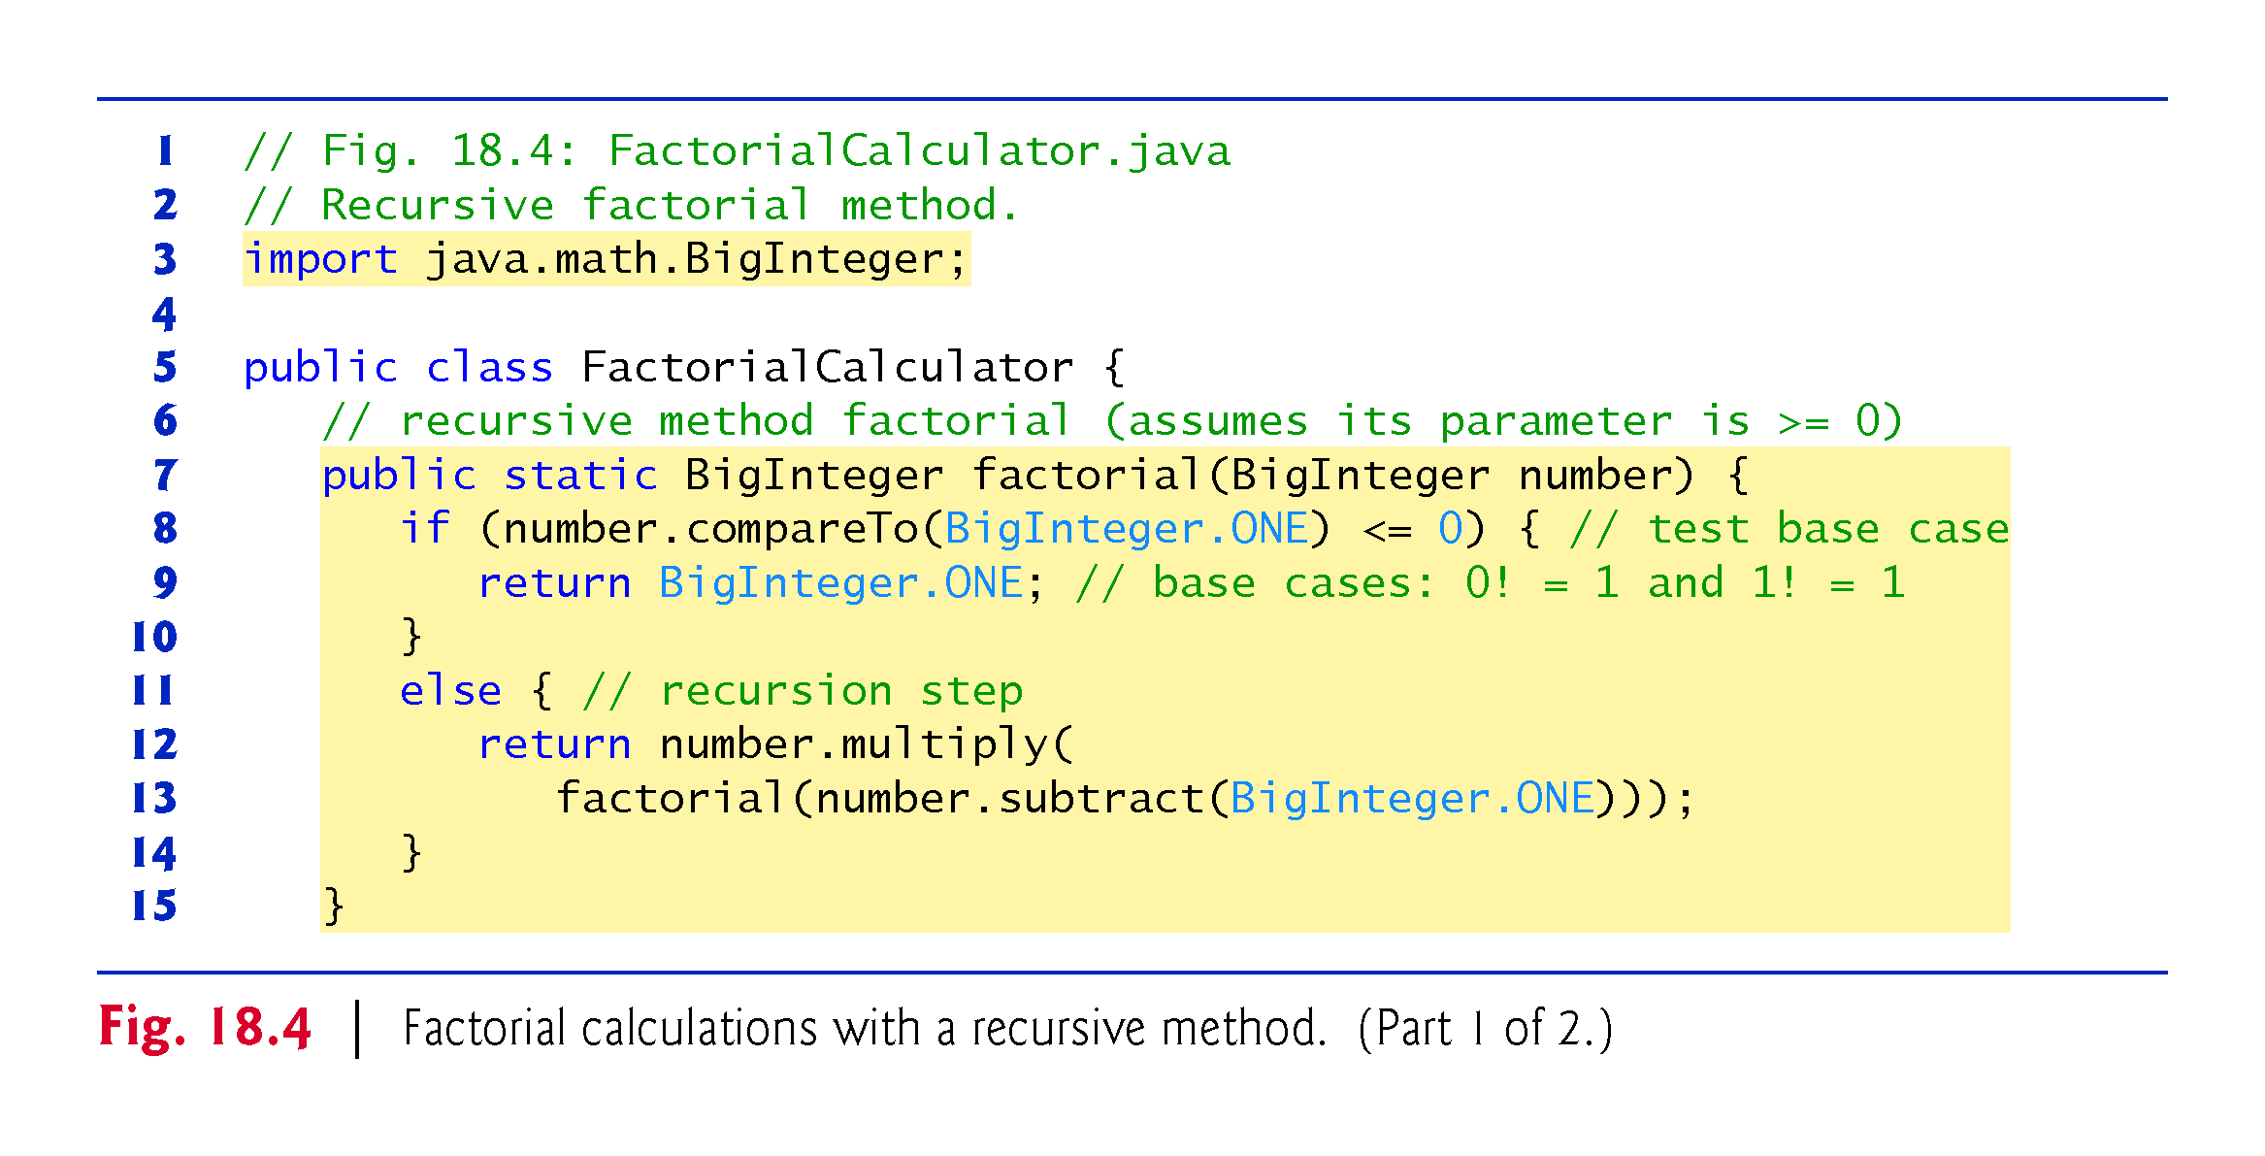

Slide 15
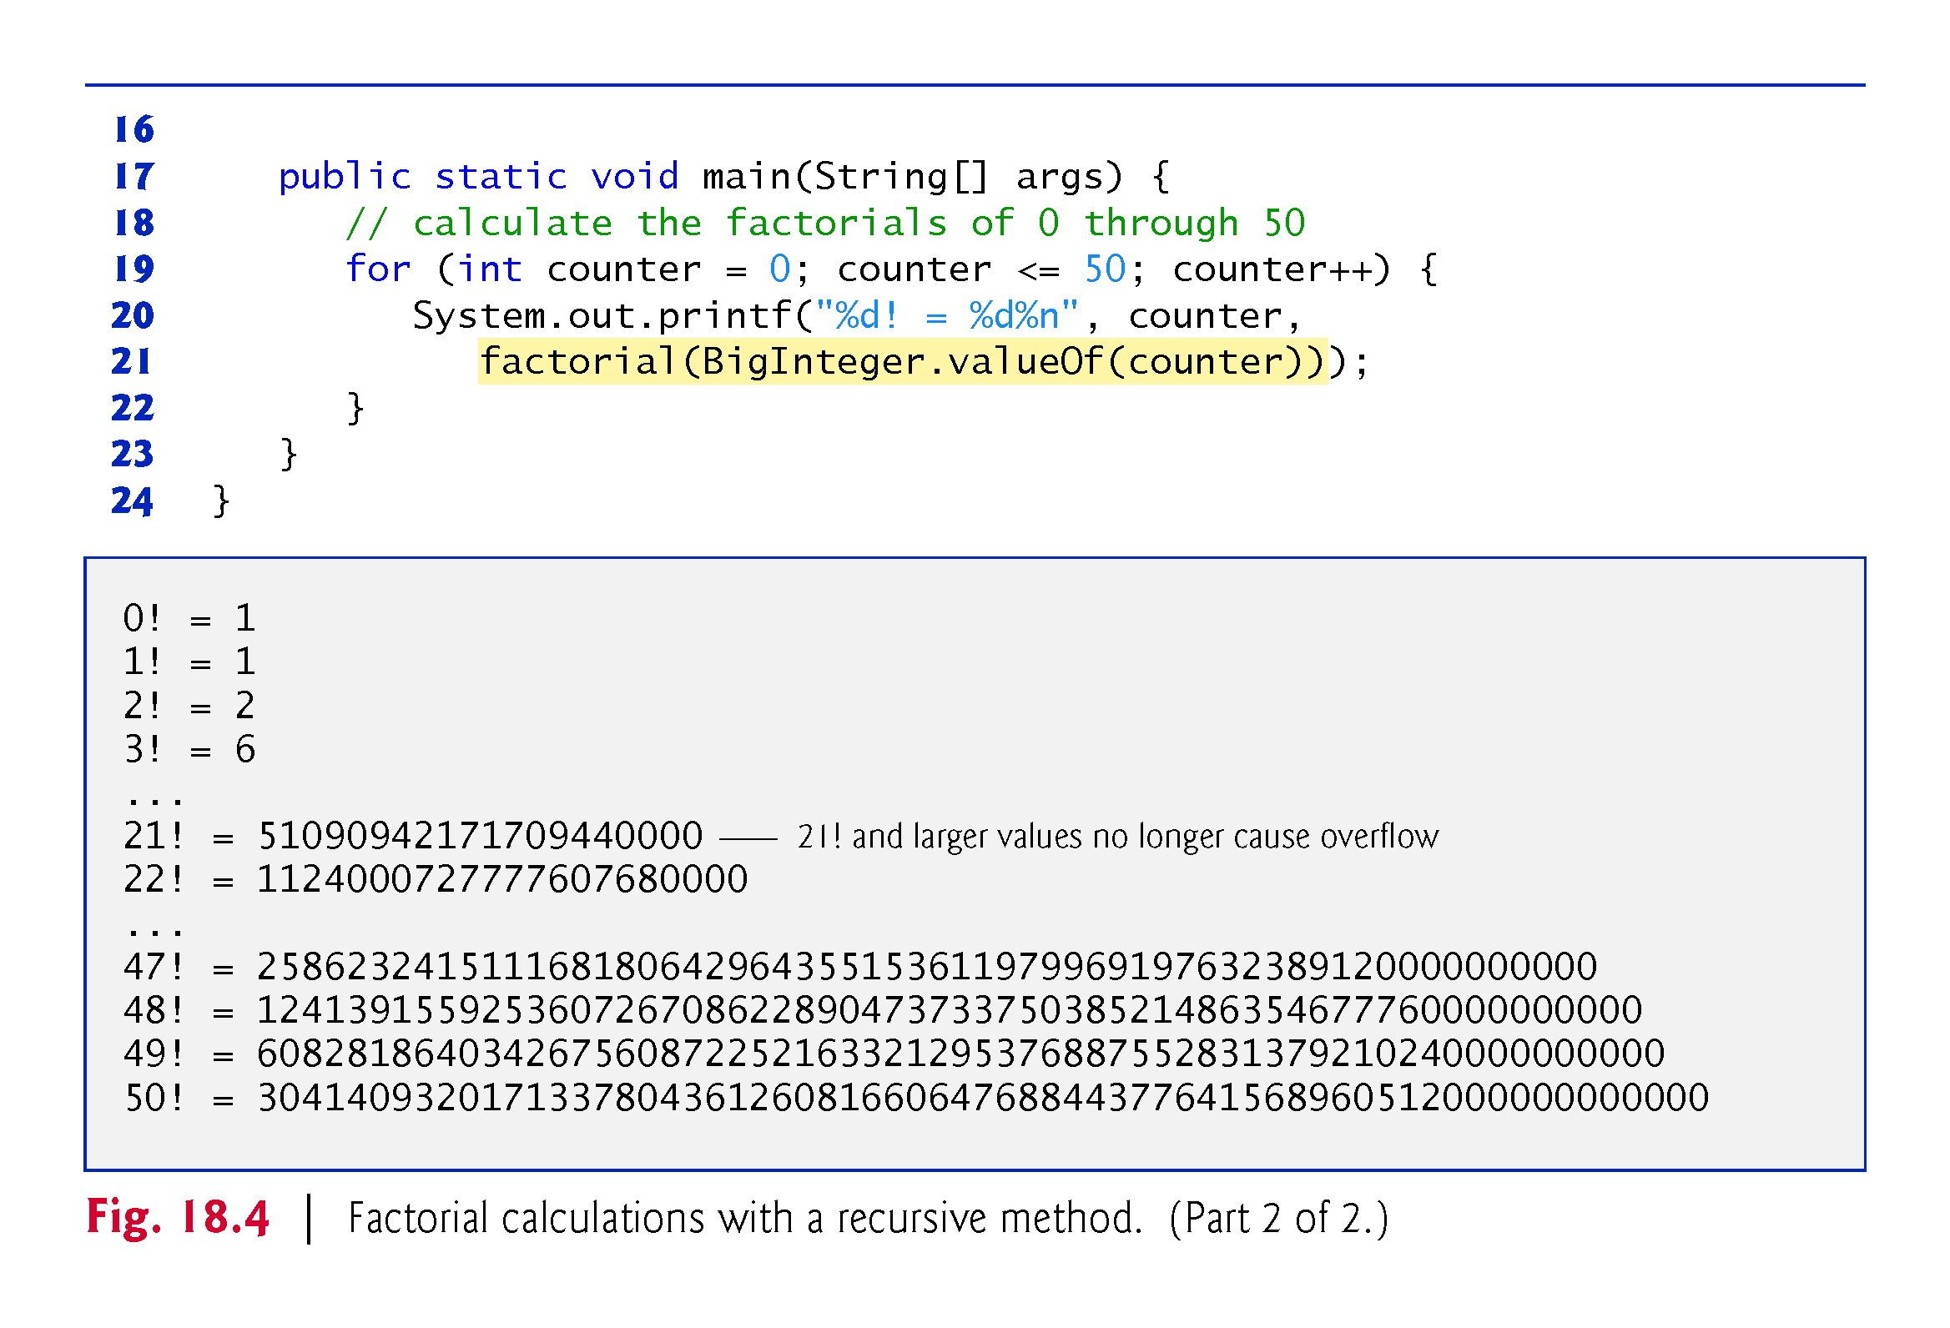

Slide 16
18.4 Reimplementing Class FactorialCalculator Using BigInteger (Cont.)
BigInteger method compareTo compares the BigInteger number that calls the method to the method’s BigInteger argument.
Returns -1 if the BigIteger that calls the method is less than the argument, 0 if they are equal or 1 if the BigInteger that calls the method is greater than the argument.
BigInteger constant ONE represents the integer value 1.
BigInteger methods multiply and subtract implement multiplication and subtraction. Similar methods are provided for other arithmetic operations

Slide 17
18.5 Example Using Recursion: Fibonacci Series
The Fibonacci series, begins with 0 and 1 and has the property that each subsequent Fibonacci number is the sum of the previous two.
0, 1, 1, 2, 3, 5, 8, 13, 21, …
This series occurs in nature and describes a form of spiral.
The ratio of successive Fibonacci numbers converges on a constant value of 1.618…,
called the golden ratio or the golden mean.
The Fibonacci series may be defined recursively as follows:
fibonacci(0) = 0 fibonacci(1) = 1 fibonacci(n) = fibonacci(n – 1) + fibonacci(n – 2)

Slide 18
18.5 Example Using Recursion: Fibonacci Series (Cont.)
Two base cases for
fibonacci(0) is defined to be 0
fibonacci(1) to be 1
Fibonacci numbers tend to become large quickly.
We use type BigInteger as the parameter type and the return type of method fibonacci.

Slide 19
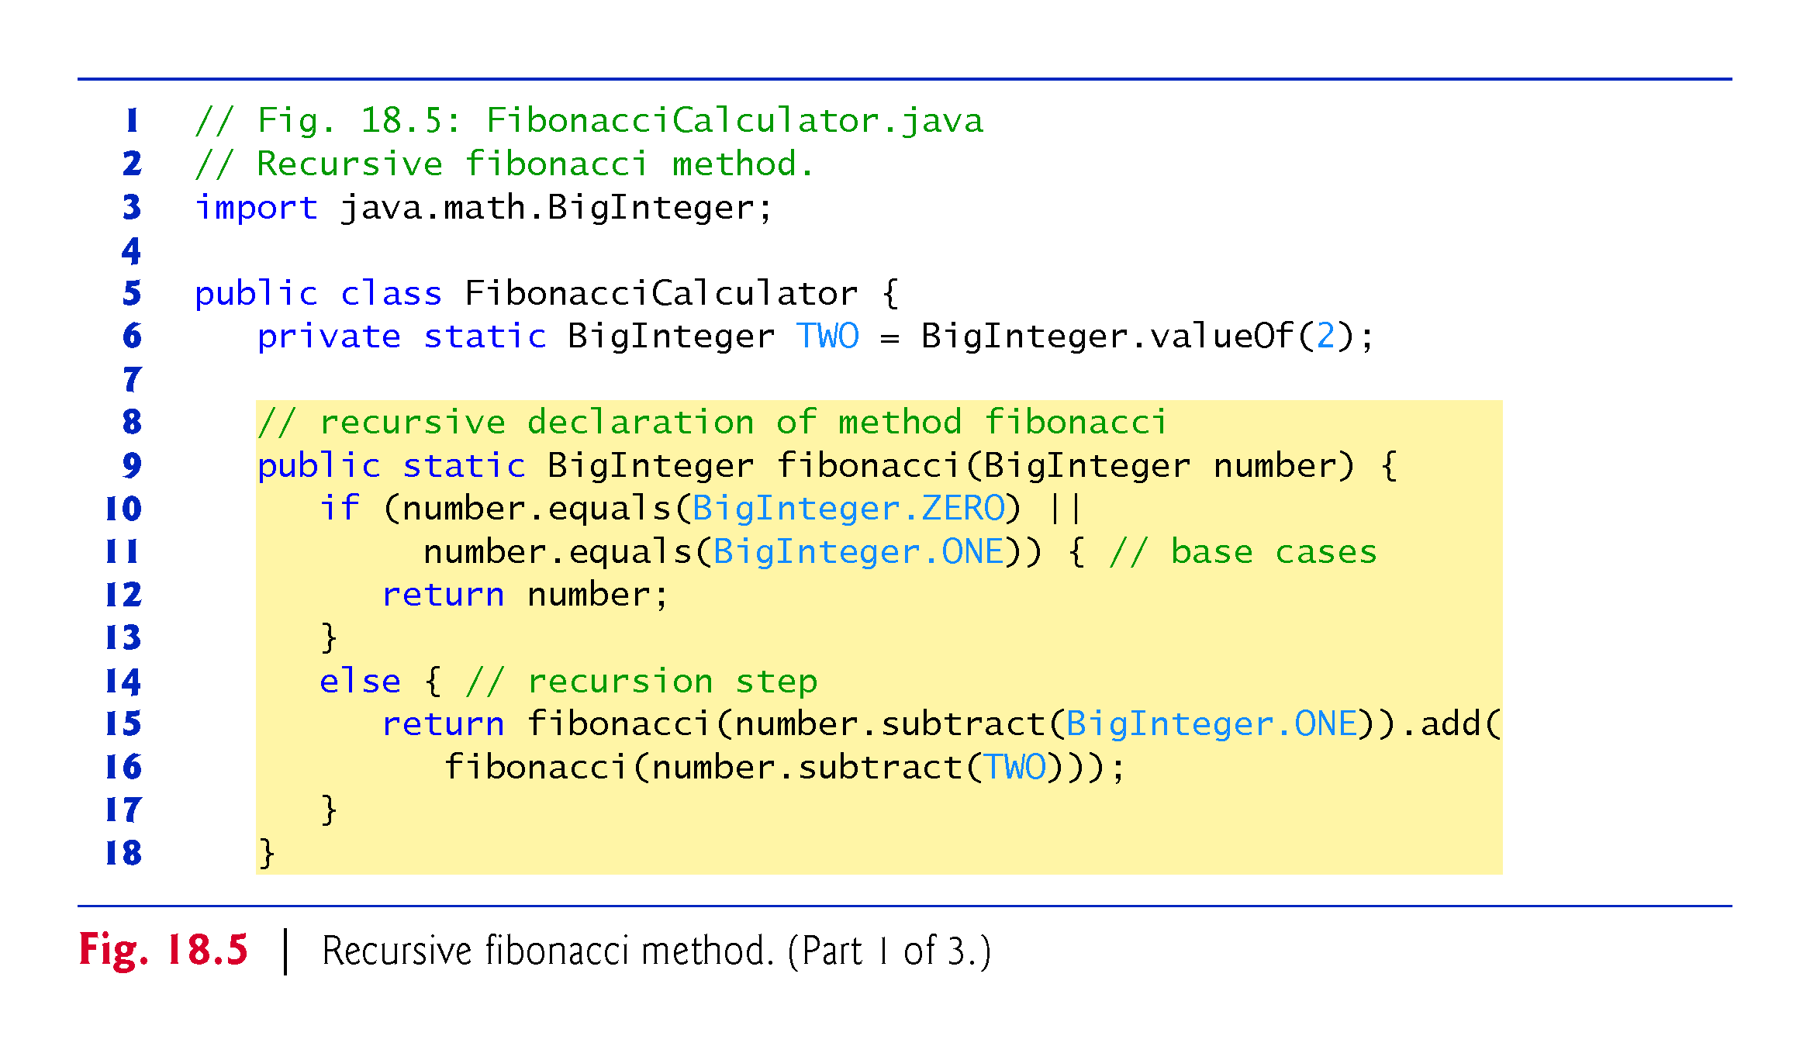

Slide 20
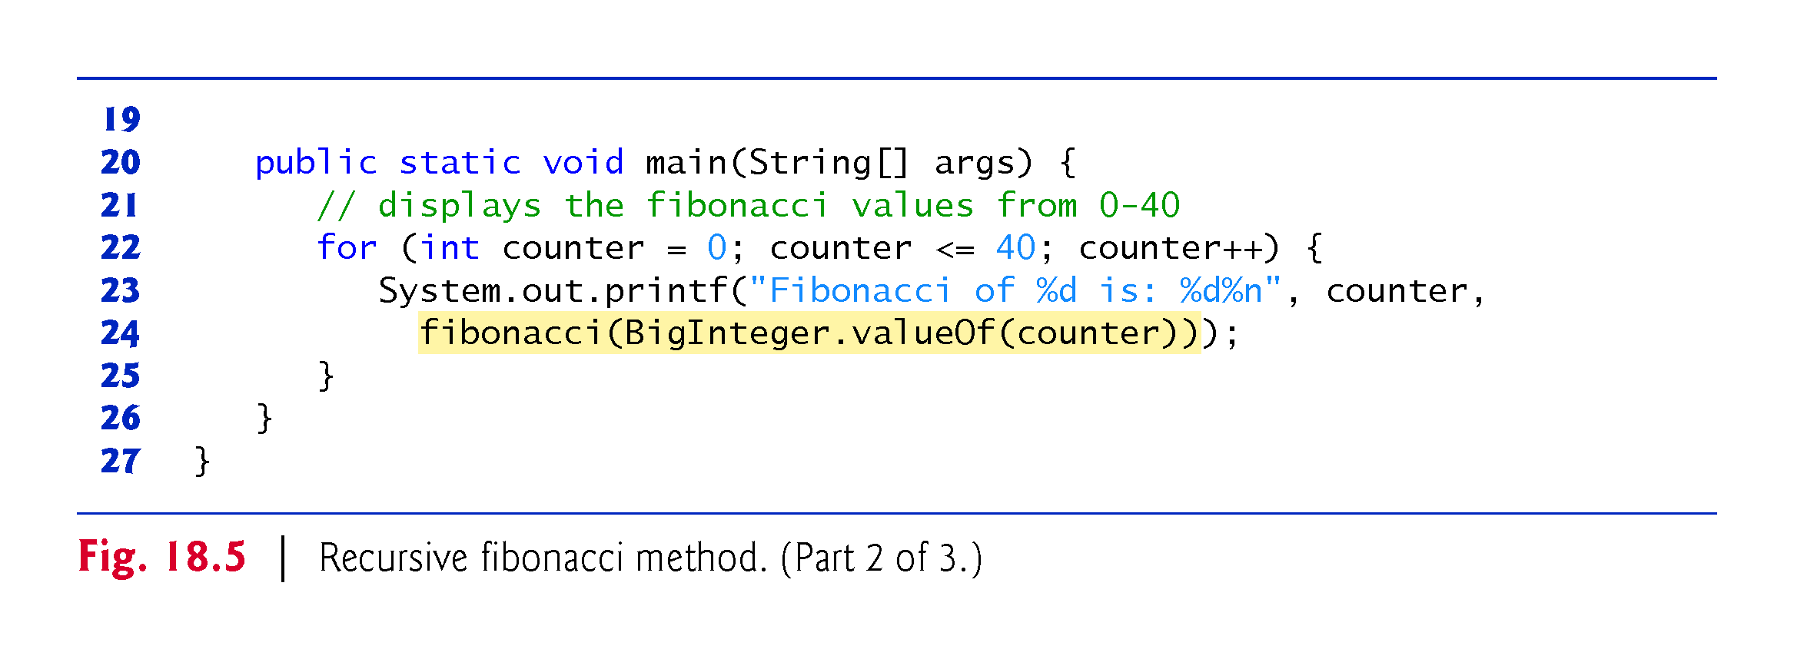

Slide 21
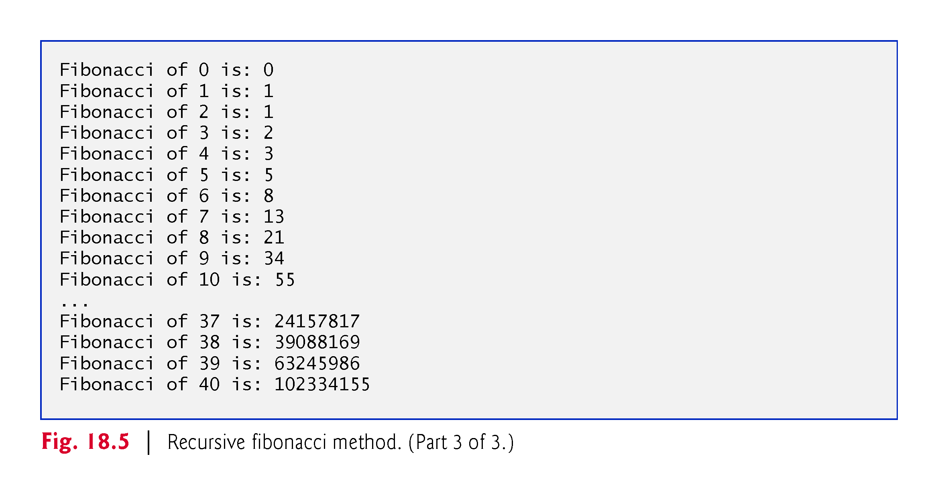

Slide 22
18.5 Example Using Recursion: Fibonacci Series (Cont.)
BigInteger constants ZERO and ONE represent the values 0 and 1, respectively.
If number is greater than 1, the recursion step generates two recursive calls, each for a slightly smaller problem than the original call to fibonacci.
BigInteger methods add and subtract are used to help implement the recursive step.

Slide 23
18.5 Example Using Recursion: Fibonacci Series (Cont.)
Figure 18.6 shows how method fibonacci evaluates fibonacci(3).
The Java language specifies that the order of evaluation of the operands is from left to right.
Thus, the call fibonacci(2) is made first and the call fibonacci(1) second.
Each invocation of the fibonacci method that does not match one of the base cases (0 or 1) results in two more recursive calls to the fibonacci method.
Calculating the Fibonacci value of 20 with the program in Fig. 18.5 requires 21,891 calls to the fibonacci method; calculating the Fibonacci value of 30 requires 2,692,537 calls!

Slide 24
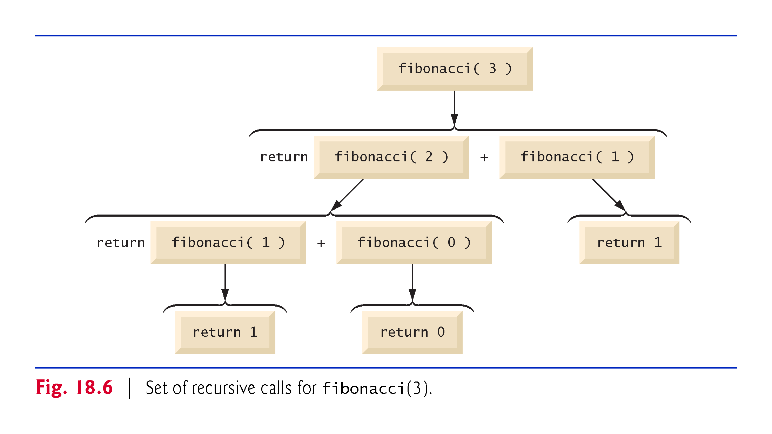

Slide 25
18.6 Recursion and the Method-Call Stack
The method-call stack and stack frames keep track of recursive method calls.

Slide 26
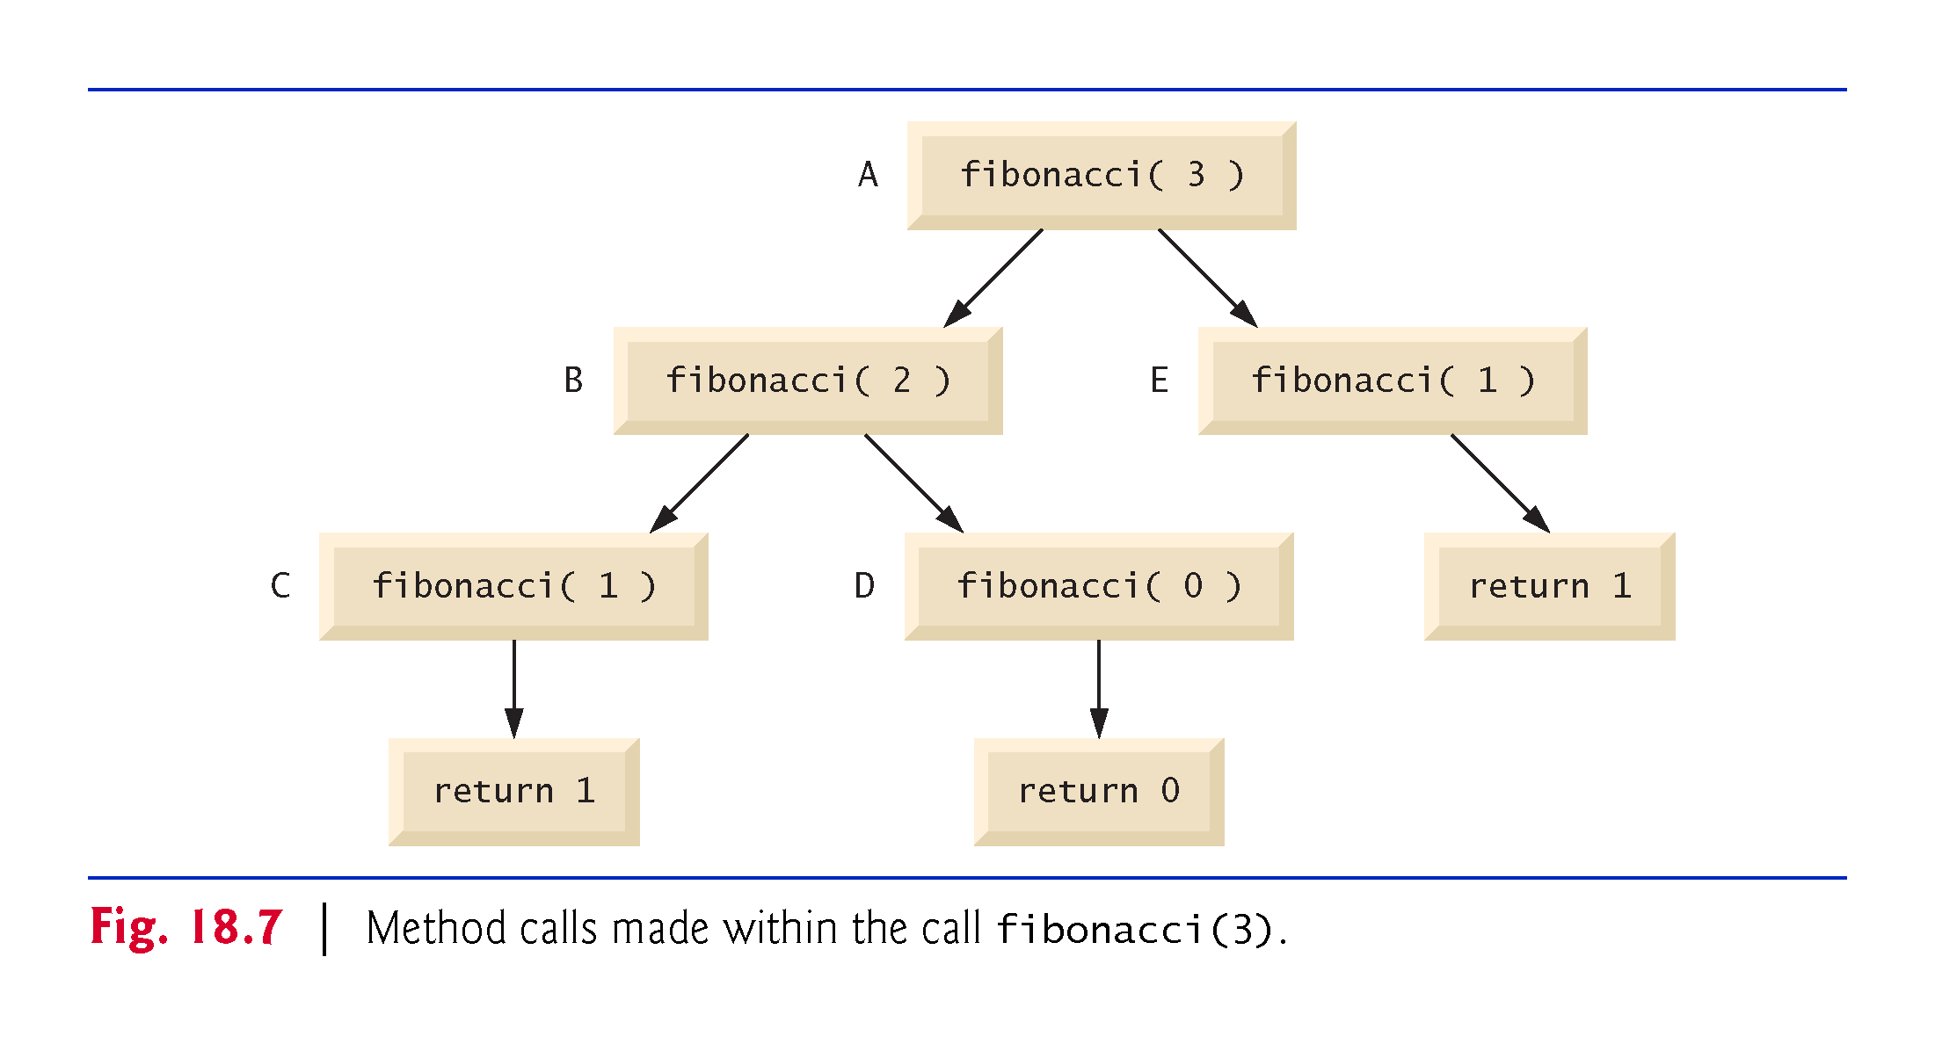

Slide 27
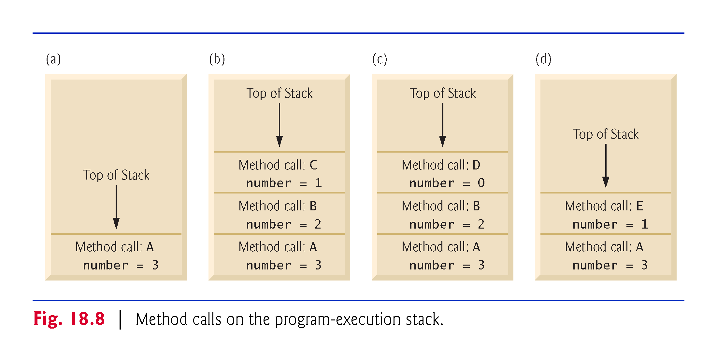

Slide 28
18.7 Recursion vs Iteration
Both iteration and recursion are based on a control statement:
Iteration uses a iteration statement (e.g., for, while or do…while)
Recursion uses a selection statement (e.g., if, if…else or switch)
Both iteration and recursion involve repetition:
Iteration explicitly uses a repetition statement
Recursion achieves repetition through repeated method calls
Iteration and recursion each involve a termination test:
Iteration terminates when the loop-continuation condition fails
Recursion terminates when a base case is reached.
Both iteration and recursion can occur infinitely:
An infinite loop occurs with iteration if the loop-continuation test never becomes false
Infinite recursion occurs if the recursion step does not reduce the problem each time in a manner that converges on the base case, or if the base case is not tested.

Slide 29
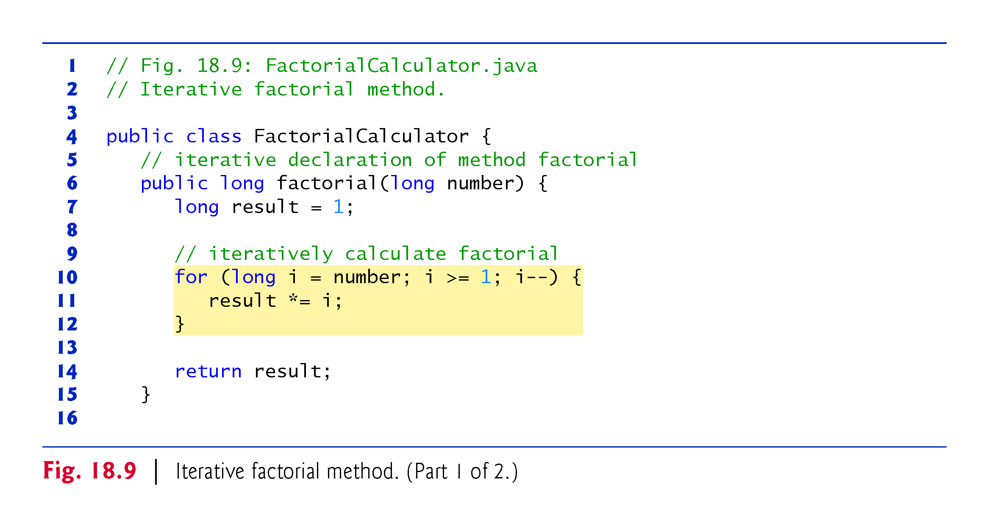

Slide 30
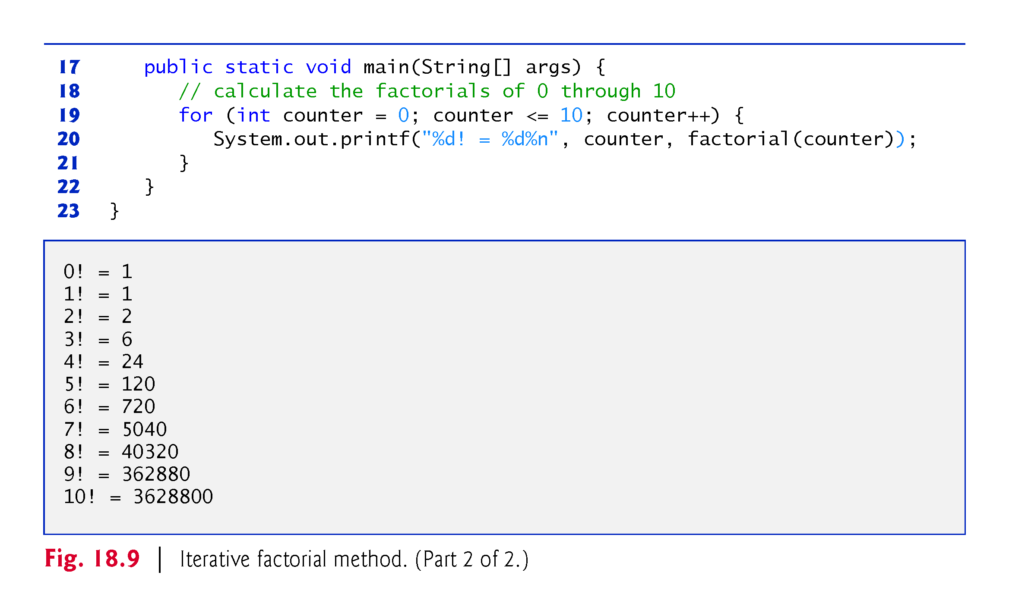

Slide 31
18.8 Towers of Hanoi
Towers of Hanoi
Move stack of disks from one peg to another under the constraints that exactly one disk is moved at a time and at no time may a larger disk be placed above a smaller disk.
Three pegs are provided, one being used for temporarily holding disks.
Moving n disks can be viewed in terms of moving only n – 1 disks (hence the recursion) as follows:
Move n – 1 disks from peg 1 to peg 2, using peg 3 as a temporary holding area.
Move the last disk (the largest) from peg 1 to peg 3.
Move n – 1 disks from peg 2 to peg 3, using peg 1 as a temporary holding area.
The process ends when the last task involves moving n = 1 disk (i.e., the base case). This task is accomplished by moving the disk, without using a temporary holding area.

Slide 32
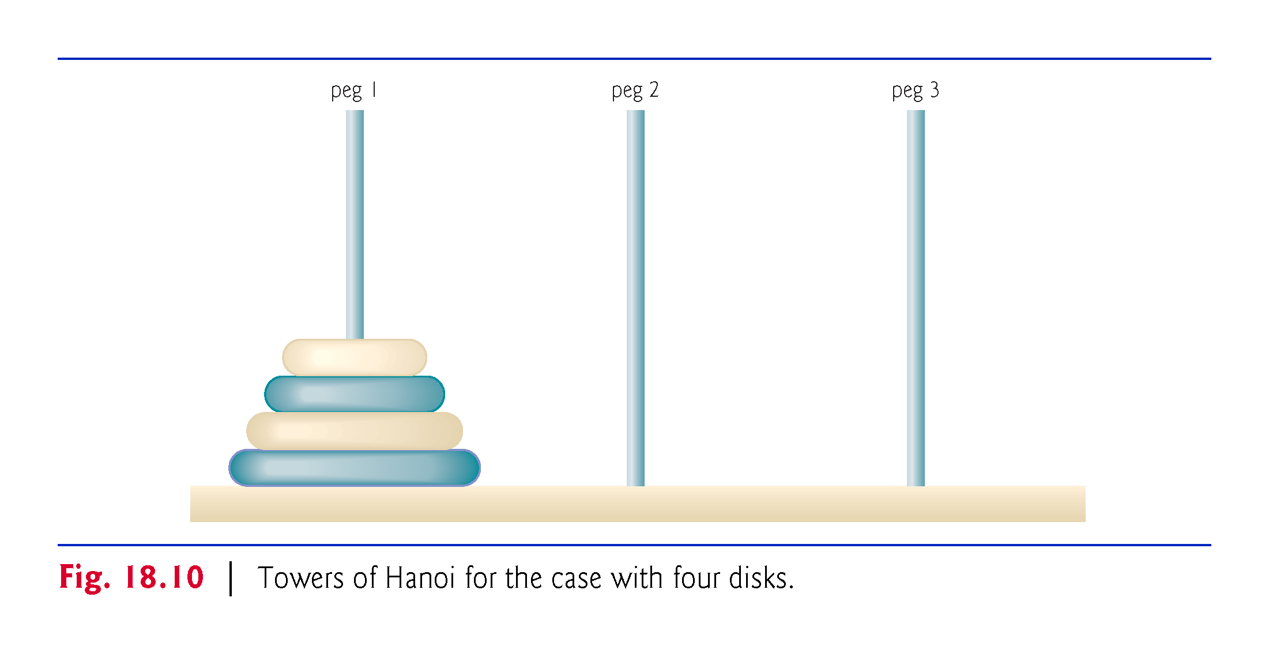

Slide 33
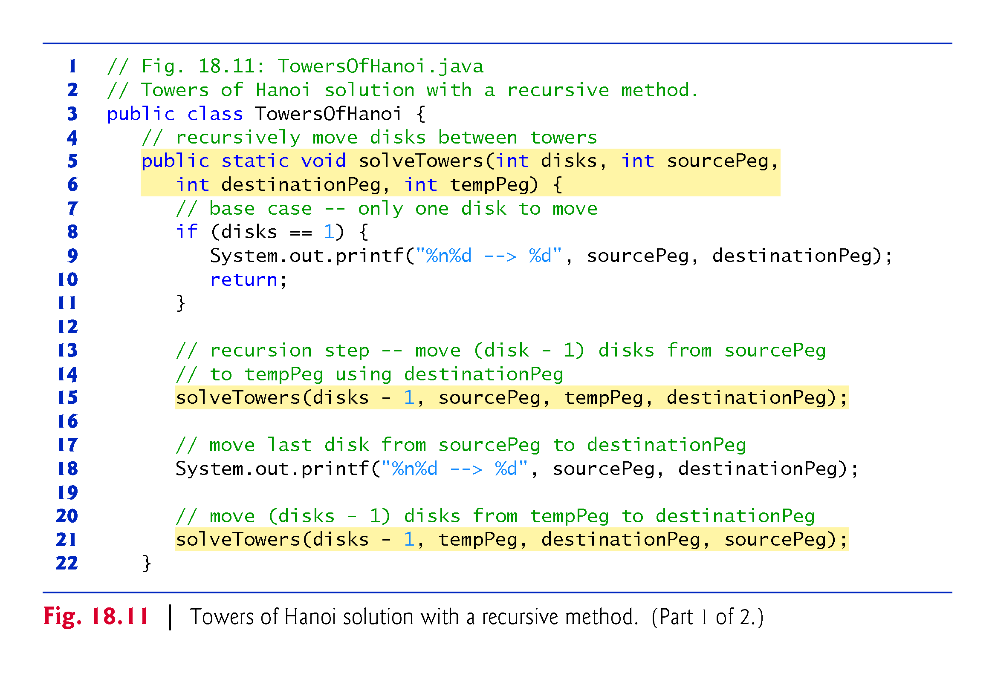

Slide 34
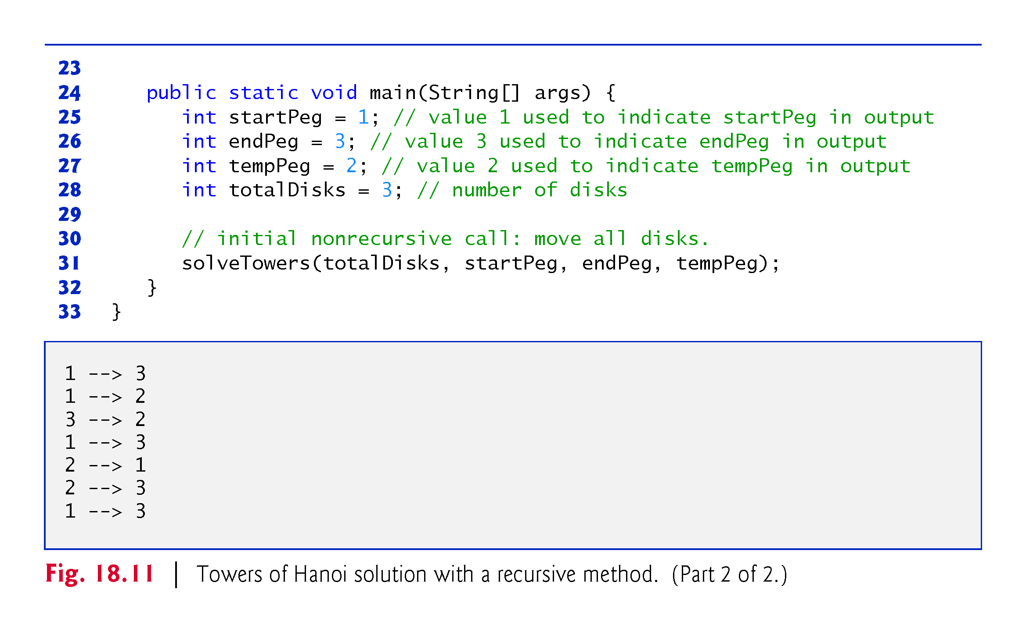

Slide 35
18.10 Recursive Backtracking
Find a path through a maze, returning true if there is a possible solution to the maze.
Involves moving through the maze one step at a time, where moves can be made by going down, right, up or left.
From the current location, for each possible direction, the move is made in that direction and a recursive call is made to solve the remainder of the maze from the new location.
When a dead end is reached, back up to the previous location and try to go in a different direction.
If no other direction can be taken, back up again.
Continue until you find a point in the maze where a move can be made in another direction.
Move in the new direction and continue with another recursive call to solve the rest of the maze.
Using recursion to return to an earlier decision point is known as recursive backtracking.

Slide 36
Chapter Objectives – What we covered
Describe the concept of recursion.
Explain recursive methods.
Determine the base case and the recursion step in a recursive algorithm.
Describe how recursive methods calls are handled by the system.
Describe the difference between recursion and iteration, and when to use each.
Describe what recursive backtracking is and why it’s an effective problem-solving technique.

Slide 37
Questions?

